Slide 1
Elasticity . . .
… allows us to analyze supply and demand with greater precision.
… is a measure of how much buyers and sellers respond to changes in market conditions

Slide 2
THE ELASTICITY OF DEMAND
The price elasticity of demand is a measure of how much the quantity demanded of a good responds to a change in the price of that good.
When we talk about elasticity, that responsiveness is always measured in percentage terms.
Specifically, the price elasticity of demand is the percentage change in quantity demanded due to a percentage change in the price.

Slide 3
The Price Elasticity of Demand and Its Determinants
Availability of Close Substitutes
Necessities versus Luxuries
Definition of the Market
Time Horizon

Slide 4
The Price Elasticity of Demand and Its Determinants
Demand tends to be more elastic:
  the larger the number of close substitutes.
  if the good is a luxury.
  the more narrowly defined the market.
  the longer the time period.

Slide 5
Computing the Price Elasticity of Demand
The price elasticity of demand is computed as the percentage change in the quantity demanded divided by the percentage change in price.

Slide 6
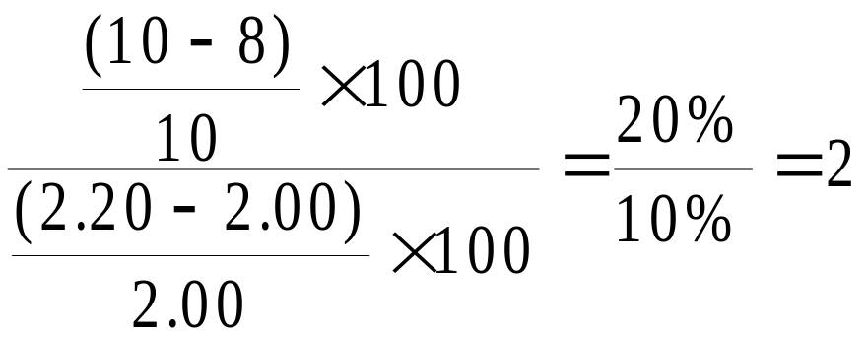
Computing the Price Elasticity of Demand
Example: If the price of an ice cream cone increases from $2.00 to $2.20 and the amount you buy falls from 10 to 8 cones, then your elasticity of demand would be calculated as:

Slide 7
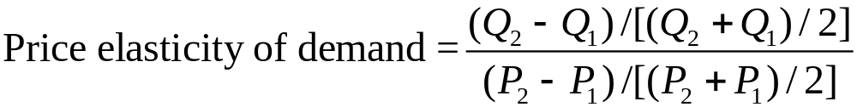
The Midpoint Method: A Better Way to Calculate Percentage Changes and Elasticities
The midpoint formula is preferable when calculating the price elasticity of demand because it gives the same answer regardless of the direction of the price change.

Slide 8
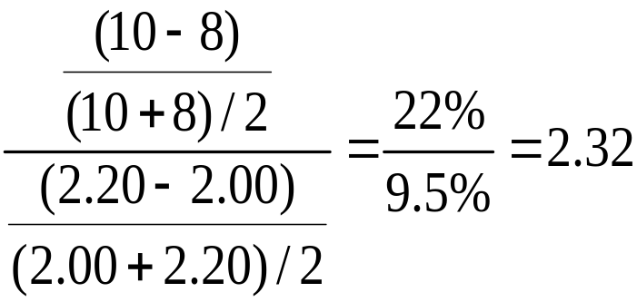
The Midpoint Method: A Better Way to Calculate Percentage Changes and Elasticities
Example: If the price of an ice cream cone increases from $2.00 to $2.20 and the amount you buy falls from 10 to 8 cones, then your elasticity of demand, using the midpoint formula, would be calculated as:

Slide 9
The Variety of Demand Curves
Inelastic Demand
  Quantity demanded does not respond strongly to price changes.
  Price elasticity of demand is less than one.
Elastic Demand
  Quantity demanded responds strongly to changes in price.
  Price elasticity of demand is greater than one.

Slide 10
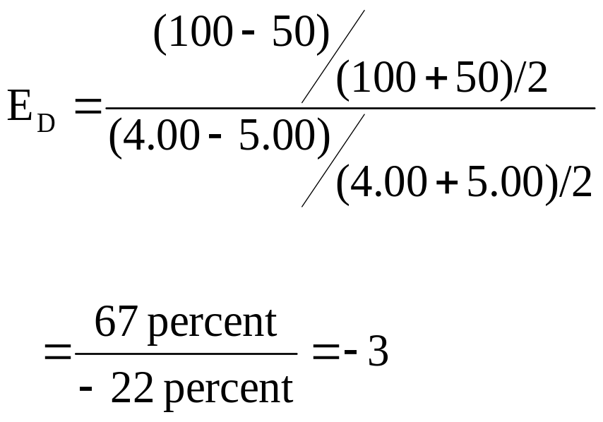
Computing the Price Elasticity of Demand
Price
$5
4
Demand
0
50
100
Quantity
Demand is price elastic.

Slide 11
The Variety of Demand Curves
Perfectly Inelastic
  Quantity demanded does not respond to price changes.
Perfectly Elastic
  Quantity demanded changes infinitely with any change in price.
Unit Elastic
  Quantity demanded changes by the same percentage as the price.

Slide 12
The Variety of Demand Curves
Because the price elasticity of demand measures how much quantity demanded responds to the price, it is closely related to the slope of the demand curve.
But it is not the same thing as the slope!

Slide 13
Figure 1 The Price Elasticity of Demand
(a) Perfectly Inelastic Demand: Elasticity Equals 0
Price
Demand
$5
4
1. An
increase
in price . . .
0
100
Quantity
2. . . . leaves the quantity demanded unchanged.

Slide 14
Figure 1 The Price Elasticity of Demand
(b) Inelastic Demand: Elasticity Is Less Than 1
Price
$5
4
1. A 22%
Demand
increase
in price . . .
0
90
100
Quantity
2. . . . leads to an 11% decrease in quantity demanded.

Slide 15
Figure 1 The Price Elasticity of Demand
(c) Unit Elastic Demand: Elasticity Equals 1
Price
$5
4
1. A 22%
Demand
increase
in price . . .
0
80
100
Quantity
2. . . . leads to a 22% decrease in quantity demanded.

Slide 16
Figure 1 The Price Elasticity of Demand
(d) Elastic Demand: Elasticity Is Greater Than 1
Price
$5
4
Demand
1. A 22%
increase
in price . . .
0
50
100
Quantity
2. . . . leads to a 67% decrease in quantity demanded.

Slide 17
Figure 1 The Price Elasticity of Demand
(e) Perfectly Elastic Demand: Elasticity Equals Infinity
Price
1. At any price
above $4, quantity
demanded is zero.
$4
Demand
2. At exactly $4,
consumers will
buy any quantity.
0
Quantity
3. At a price below $4,
quantity demanded is infinite.

Slide 18

Total Revenue and the Price Elasticity of Demand
Total revenue is the amount paid by buyers and received by sellers of a good.
Computed as the price of the good times the quantity sold.

Slide 19
Figure 2 Total Revenue
Price
When the price is $4, consumers will demand 100 units, and spend $400 on this good.
$4
P × Q = $400
P
(revenue)
Demand
0
100
Quantity
Q

Slide 20
Elasticity and Total Revenue along a Linear Demand Curve
With an inelastic demand curve, an increase in price leads to a decrease in quantity that is proportionately smaller. Thus, total revenue increases.

Slide 21
Figure 3 How Total Revenue Changes When Price Changes: Inelastic Demand
Price
Price
An Increase in price from $1
to $3 …
… leads to an Increase in total revenue from $100 to $240
$3
Revenue = $240
$1
Revenue = $100
Demand
Demand
0
100
Quantity
0
80
Quantity

Slide 22
Elasticity and Total Revenue along a Linear Demand Curve
With an elastic demand curve, an increase in the price leads to a decrease in quantity demanded that is proportionately larger. Thus, total revenue decreases.

Slide 23
Figure 3 How Total Revenue Changes When Price Changes: Elastic Demand
Price
Price
An Increase in price from $4
to $5 …
… leads to an decrease in total revenue from $200 to $100
$5
$4
Demand
Demand
Revenue = $200
Revenue = $100
0
50
Quantity
0
20
Quantity
Note that with each price increase, the Law of Demand still holds – an increase in price leads to a decrease in the quantity demanded. It is the change in TR that varies!

Slide 24
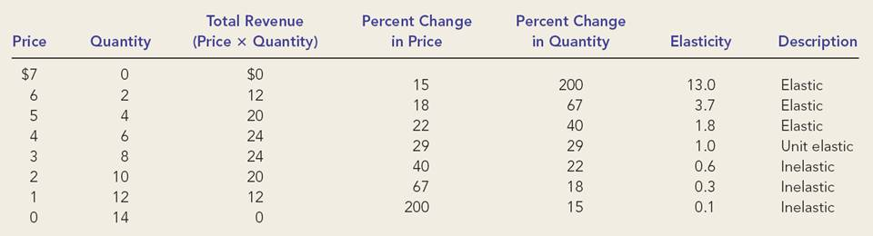
Elasticity of a Linear Demand Curve

Slide 25
Figure 4 Elasticity of a Linear Demand Curve
Demand is elastic; demand is responsive to changes in price.
When price increases from $4 to $5, TR declines from $24 to $20.
Price
$7
Elasticity is > 1 in this range.
6
5
4
Elasticity is < 1 in this range.
Demand is inelastic; demand is not very responsive to changes in price.
3
When price increases from $2 to $3, TR increases from $20 to $24.
2
1
0
2
4
6
8
10
12
14
Quantity

Slide 26
Other Demand Elasticities
Income Elasticity of Demand
  Income elasticity of demand measures how much the quantity demanded of a good responds to a change in consumers’ income.
  It is computed as the percentage change in the quantity demanded divided by the percentage change in income.

Slide 27
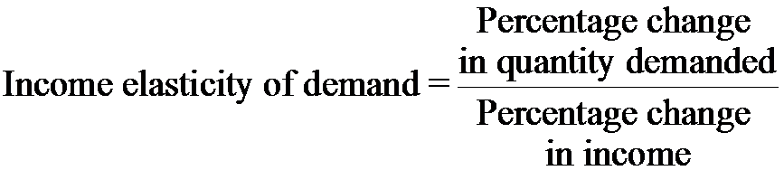
Other Demand Elasticities
Computing Income Elasticity
Remember, all elasticities are measured by dividing one percentage change by another

Slide 28
Other Demand Elasticities
Income Elasticity
  Types of Goods
    Normal Goods
    Inferior Goods
  Higher income raises the quantity demanded for normal goods but lowers the quantity demanded for inferior goods.

Slide 29
Other Demand Elasticities
Income Elasticity
  Goods consumers regard as necessities tend to be income inelastic
    Examples include food, fuel, clothing, utilities, and medical services.
  Goods consumers regard as luxuries tend to be income elastic.
    Examples include sports cars, furs, and expensive foods.

Slide 30
Other Demand Elasticities
Cross-price elasticity of demand
  A measure of how much the quantity demanded of one good responds to a change in the price of another good, computed as the percentage change in quantity demanded of the first good divided by the percentage change in the price of the second good

Slide 31
THE ELASTICITY OF SUPPLY
Price elasticity of supply is a measure of how much the quantity supplied of a good responds to a change in the price of that good.
Price elasticity of supply is the percentage change in quantity supplied resulting from a percentage change in price.

Slide 32
Figure 5 The Price Elasticity of Supply
(a) Perfectly Inelastic Supply: Elasticity Equals 0
Price
Supply
$5
4
1. An
increase
in price . . .
0
100
Quantity
2. . . . leaves the quantity supplied unchanged.

Slide 33
Figure 5 The Price Elasticity of Supply
(b) Inelastic Supply: Elasticity Is Less Than 1
Price
Supply
$5
4
1. A 22%
increase
in price . . .
0
100
110
Quantity
2. . . . leads to a 10% increase in quantity supplied.

Slide 34
Figure 5 The Price Elasticity of Supply
(c) Unit Elastic Supply: Elasticity Equals 1
Price
Supply
$5
4
(If SUPPLY is unit elastic and linear, it will begin at the origin.)
1. A 22%
increase
in price . . .
0
100
125
Quantity
2. . . . leads to a 22% increase in quantity supplied.

Slide 35
Figure 5 The Price Elasticity of Supply
(d) Elastic Supply: Elasticity Is Greater Than 1
Price
Supply
$5
4
1. A 22%
increase
in price . . .
0
100
200
Quantity
2. . . . leads to a 67% increase in quantity supplied.

Slide 36
Figure 5 The Price Elasticity of Supply
(e) Perfectly Elastic Supply: Elasticity Equals Infinity
Price
1. At any price
above $4, quantity
supplied is infinite.
$4
Supply
2. At exactly $4,
producers will
supply any quantity.
0
Quantity
3. At a price below $4,
quantity supplied is zero.

Slide 37
The Price Elasticity of Supply and Its Determinants
Ability of sellers to change the amount of the good they produce.
  Beach-front land is inelastic.
  Books, cars, or manufactured goods are elastic.
Time period
  Supply is more elastic in the long run.

Slide 38
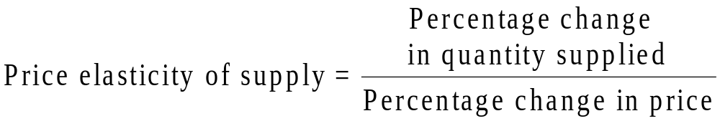
Computing the Price Elasticity of Supply
The price elasticity of supply is computed as the percentage change in the quantity supplied divided by the percentage change in price.

Slide 39
THREE APPLICATIONS OF SUPPLY, DEMAND, AND ELASTICITY
Can good news for farming be bad news for farmers?
What happens to wheat farmers and the market for wheat when university agronomists discover a new wheat hybrid that is more productive than existing varieties?

Slide 40
Can Good News for Farming Be Bad News for Farmers?
Examine whether the supply or demand curve shifts.
Determine the direction of the shift of the curve.
Use the supply-and-demand diagram to see how the market equilibrium changes.

Slide 41
Figure 7 An Increase in Supply in the Market for Wheat
Price of
Wheat
1. When demand is inelastic,
2. . . . leads
an increase in supply
. . .
to a large fall
S₁
in price . . .
S₂
$3
2
Demand
0
100
110
Quantity of
Wheat
3. . . . and a proportionately smaller
increase in quantity sold. As a result,
revenue falls from $300 to $220.

Slide 42
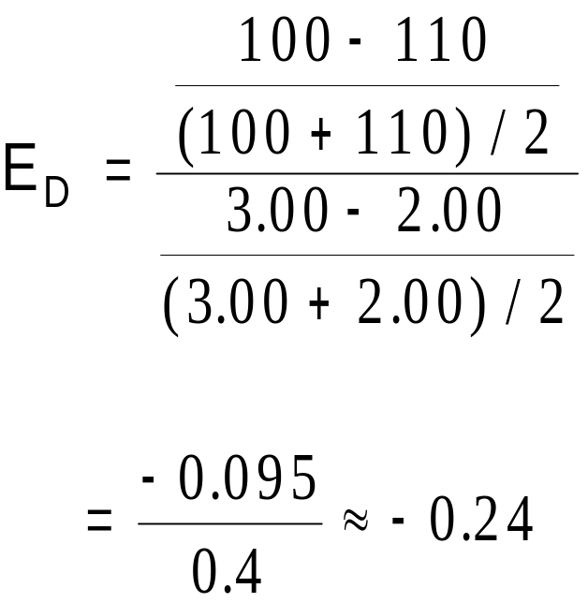
Compute the Price Elasticity of Demand When There Is a Change in Supply
Demand is inelastic.

Slide 43
Why Did OPEC Fail to Keep the Price of Oil High?
Supply and Demand can behave differently in the short run and the long run
  In the short run, both supply and demand for oil are relatively inelastic
  But in the long run, both are elastic
    Production outside of OPEC
    More conservation by consumers

Slide 44
Does Drug Interdiction Increase or Decrease Drug-Related Crime?
Drug interdiction impacts sellers rather than buyers.
  Demand is unchanged.
  Equilibrium price rises although quantity falls.
Drug education impacts the buyers rather than sellers.
  Demand is shifted.
  Equilibrium price and quantity are lowered.

Slide 45
Figure 9 Policies to Reduce the Use of Illegal Drugs
Drug Interdiction
Drug Education
Price of Drugs
Price of Drugs
S₂
S₁
S₁
It is amazing how useful knowledge of elasticities can be!
D₁
D₁
D₂
Quantity of Drugs
Quantity of Drugs
In each case, the change in price is the same.
But in one market the price goes up.
The demand for illegal drugs is inelastic.
Interdiction shifts the supply,
while education shifts the demand.
The changes in quantities (and TR) are remarkable.
And in the other it goes down.

Slide 46
Supply, Demand, and Government Policies
In a free, unregulated market system, market forces establish equilibrium prices and exchange quantities.
While equilibrium conditions may be efficient, it may be true that not everyone is satisfied.
One of the roles of economists is to use their theories to assist in the development of policies.
Notes:
2
2

Slide 47
CONTROLS ON PRICES
Are usually enacted when policymakers believe the market price is unfair to buyers or sellers.
Result in government-created price ceilings and floors.
Notes:
3
3

Slide 48
CONTROLS ON PRICES
Price Ceiling
  A legal maximum on the price at which a good can be sold.
Price Floor
  A legal minimum on the price at which a good can be sold.
Notes:
4
4

Slide 49
How Price Ceilings Affect Market Outcomes
Two outcomes are possible when the government imposes a price ceiling:
  The price ceiling is not binding if set above the equilibrium price.
  The price ceiling is binding if set below the equilibrium price, leading to a shortage.
Notes:
5
5

Slide 50
Figure 1 A Market with a Price Ceiling
(a) A Price Ceiling That Is Not Binding
Price of
Ice-Cream
Cone
Supply
$4
Price
ceiling
3
The market clears at $3 and the price ceiling is ineffective.
Equilibrium
price
Demand
0
100
Quantity of
Equilibrium
Ice-Cream
quantity
Cones

Slide 51
Figure 1 A Market with a Price Ceiling
(b) A Price Ceiling That Is Binding
Price of
Ice-Cream
Cone
Supply
Equilibrium
price
$3
2
Price
Shortage
ceiling
Demand
0
75
125
Quantity of
Quantity
Quantity
Ice-Cream
supplied
demanded
Cones

Slide 52
How Price Ceilings Affect Market Outcomes
Effects of Price Ceilings
A binding price ceiling creates
  Shortages because Q_{D} > Q_{S}.
    Example: Gasoline shortage of the 1970s
  Nonprice rationing
    Examples: Long lines, discrimination by sellers
Notes:
14
11

Slide 53


CASE STUDY: Lines at the Gas Pump
In 1973, OPEC raised the price of crude oil in world markets. Crude oil is the major input in gasoline, so the higher oil prices reduced the supply of gasoline.
What was responsible for the long gas lines?
Economists blame government regulations that limited the price oil companies could charge for gasoline.

Slide 54
Figure 2 The Market for Gasoline with a Price Ceiling
(a) The Price Ceiling on Gasoline Is Not Binding
Price of
Gasoline
Supply,
S₁
1. Initially,
the price
ceiling
is not
binding . . .
Price ceiling
P₁
Demand
0
Q₁
Quantity of
Gasoline

Slide 55
Figure 2 The Market for Gasoline with a Price Ceiling
(b) The Price Ceiling on Gasoline Is Binding
Price of
S₂
Gasoline
2. . . . but when
supply falls . . .
S₁
P₂
Price ceiling
P₁
3. . . . the price
4. . . .
ceiling becomes
resulting
binding . . .
in a
shortage.
Demand
0
Q_{S}
Q_{D}
Q₁
Quantity of
Gasoline

Slide 56
CASE STUDY: Rent Control in the Short Run and Long Run
Rent controls are ceilings placed on the rents that landlords may charge their tenants.
The goal of rent control policy is to help the poor by making housing more affordable.
One economist called rent control “the best way to destroy a city, other than bombing.”
Notes:
2

Slide 57
Figure 3 Rent Control in the Short Run and in the Long Run
(a) Rent Control in the Short Run
(supply and demand are inelastic)
Rental
Price of
Apartment
Supply
Controlled rent
Shortage
Demand
0
Quantity of
Apartments

Slide 58
Figure 3 Rent Control in the Short Run and in the Long Run
(b) Rent Control in the Long Run
(supply and demand are elastic)
Rental
Price of
Apartment
Supply
Controlled rent
Shortage
Demand
0
Quantity of
Apartments

Slide 59
How Price Floors Affect Market Outcomes
When the government imposes a price floor, two outcomes are possible.
  The price floor is not binding if set below the equilibrium price.
  The price floor is binding if set above the equilibrium price, leading to a surplus.
Notes:
15
12

Slide 60
Figure 4 A Market with a Price Floor
(a) A Price Floor That Is Not Binding
The government says that ice-cream cones must sell for at least $2; this legislation is ineffective at the current market price.
Price of
Ice-Cream
Cone
Supply
Equilibrium
price
$3
Price
floor
2
Demand
0
100
Quantity of
Equilibrium
Ice-Cream
quantity
Cones

Slide 61
Figure 4 A Market with a Price Floor
(b) A Price Floor That Is Binding
Price of
Ice-Cream
Cone
Supply
Surplus
$4
Price
floor
3
Equilibrium
price
Demand
0
80
120
Quantity of
Quantity
Quantity
Ice-Cream
demanded
supplied
Cones

Slide 62
How Price Floors Affect Market Outcomes
A price floor prevents supply and demand from moving toward the equilibrium price and quantity.
When the market price hits the floor, it can fall no further, and the market price equals the floor price.
Notes:
24
15

Slide 63
How Price Floors Affect Market Outcomes
A binding price floor causes . . .
  a surplus because Q_{S} > Q_{D}.
  nonprice rationing is an alternative mechanism for rationing the good, using discrimination criteria.
    Examples: The minimum wage, agricultural price supports
Notes:
25
15

Slide 64

CASE STUDY: The Minimum Wage
An important example of a price floor is the minimum wage.
Minimum wage laws dictate the lowest price possible for labor that any employer may pay.

Slide 65
Figure 5 How the Minimum Wage Affects the Labor Market
Wage
Labor
Supply
Equilibrium
wage
Labor
demand
0
Equilibrium
employment
Quantity of
Labor

Slide 66
Figure 5 How the Minimum Wage Affects the Labor Market
Wage
Labor
Supply
Labor surplus
(unemployment)
Minimum
wage
Labor
demand
0
Quantity
demanded
Quantity
supplied
Quantity of
Labor

Slide 67
TAXES
Governments levy taxes to raise revenue for public projects.
Notes:
29
20

Slide 68

How Taxes on Buyers (and Sellers) Affect Market Outcomes
Taxes discourage market activity.
When a good is taxed, the
quantity sold is smaller.
Buyers and sellers share
the tax burden.
Notes:
30
22

Slide 69
How Taxes on Buyers Affect Market Outcomes
Elasticity and tax incidence
  Tax incidence is the manner in which the burden of a tax is shared among participants in a market.
Notes:
31
21

Slide 70
How Taxes on Buyers Affect Market Outcomes
Elasticity and Tax Incidence
  Tax incidence is the study of who bears the burden of a tax.
  Taxes result in a change in market equilibrium.
  Buyers pay more and sellers receive less, regardless of whom the tax is levied on.
Notes:
31
21

Slide 71
Figure 6 A Tax on Buyers
Price of
Ice-Cream
Price
Cone
Supply,
S₁
buyers
pay
$3.30
Equilibrium without tax
Price
3.00
Tax ($0.50)
2.80
A tax on buyers
without
shifts the demand
tax
curve downward
Price
by the size of
Equilibrium
the tax ($0.50).
sellers
with tax
receive
D₁
D₂
0
90
100
Quantity of
Ice-Cream Cones

Slide 72
Figure 7 A Tax on Sellers
Price of
Ice-Cream
A tax on sellers
Price
Cone
Equilibrium
S₂
shifts the supply
buyers
with tax
curve upward
pay
by the amount of
$3.30
S₁
Tax ($0.50)
the tax ($0.50).
Price
3.00
without
2.80
Equilibrium without tax
tax
Price
sellers
receive
Demand,
D₁
0
90
100
Quantity of
Ice-Cream Cones

Slide 73
Elasticity and Tax Incidence
What was the impact of tax?
  Taxes discourage market activity.
  When a good is taxed, the quantity sold is smaller.
  Buyers and sellers share the tax burden.
Notes:
30
22

Slide 74
Figure 8 A Payroll Tax
Wage
Labor supply
Wage firms pay
Tax wedge
Wage without tax
Wage workers
receive
Labor demand
0
Quantity
of Labor

Slide 75
Elasticity and Tax Incidence
In what proportions is the burden of the tax divided?
How do the effects of taxes on sellers compare to those levied on buyers?
The answers to these questions depend on the elasticity of demand and the elasticity of supply.
Notes:
39
29

Slide 76
Figure 9 How the Burden of a Tax Is Divided
(a) Elastic Supply, Inelastic Demand
Price
1. When supply is more elastic
than demand . . .
Price buyers pay
Supply
Tax
2. . . . the
incidence of the
Price without tax
tax falls more
heavily on
Price sellers
consumers . . .
receive
3. . . . than
Demand
on producers.
0
Quantity

Slide 77
Figure 9 How the Burden of a Tax Is Divided
(b) Inelastic Supply, Elastic Demand
Price
1. When demand is more elastic
than supply . . .
Price buyers pay
Supply
Price without tax
3. . . . than on
consumers.
Tax
2. . . . the
Demand
Price sellers
incidence of
receive
the tax falls
more heavily
on producers . . .
0
Quantity

Slide 78

Elasticity and Tax Incidence
So, how is the burden of the tax divided?
The burden of a tax falls more
heavily on the side of the
market that is less elastic.
Notes:
41
30

Slide 79
Price elasticity of demand measures how much the quantity demanded responds to changes in the price.
Price elasticity of demand is calculated as the percentage change in quantity demanded divided by the percentage change in price.
  If a demand curve is elastic, total revenue falls when the price rises.
  If it is inelastic, total revenue rises as the price rises.

Slide 80
The income elasticity of demand measures how much the quantity demanded responds to changes in consumers’ income.
The cross-price elasticity of demand measures how much the quantity demanded of one good responds to the price of another good.
The price elasticity of supply measures how much the quantity supplied responds to changes in the price.

Slide 81
In most markets, supply is more elastic in the long run than in the short run.
The price elasticity of supply is calculated as the percentage change in quantity supplied divided by the percentage change in price.
The tools of supply and demand can be applied in many different types of markets.

Slide 82
Price controls include price ceilings and price floors.
A price ceiling is a legal maximum on the price of a good or service.
  An example is rent control.
A price floor is a legal minimum on the price of a good or a service.
  An example is the minimum wage.

Slide 83
Taxes are used to raise revenue for public purposes.
When the government levies a tax on a good, the equilibrium quantity of the good falls.
A tax on a good places a wedge between the price paid by buyers and the price received by sellers.

Slide 84
The incidence of a tax refers to who bears the burden of a tax.
The incidence of a tax does not depend on whether the tax is levied on buyers or sellers.
The incidence of the tax depends on the price elasticities of supply and demand.
The burden tends to fall on the side of the market that is less elastic.

